Slide 1
Natural Abundance Correction in PREMISE
Patrick Shepherd

Slide 2
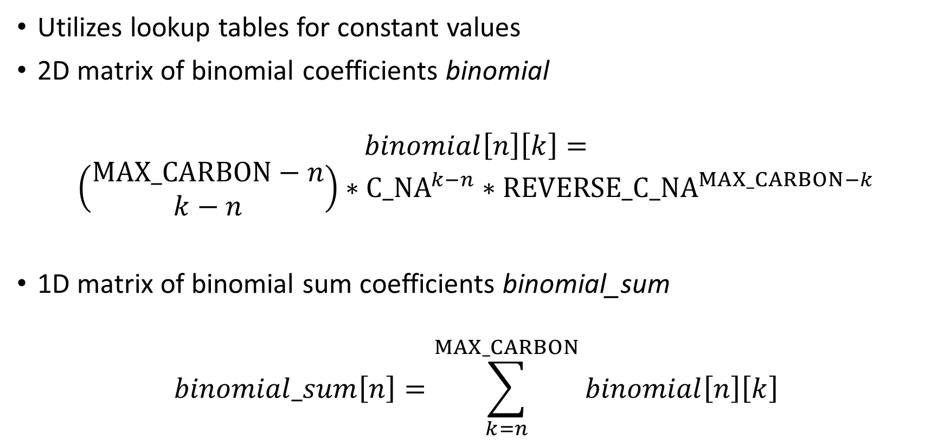
Original Single Tracer Algorithm (1)
Utilizes lookup tables for constant values
2D matrix of binomial coefficients binomial
$$binomial\left[n\right]\left[k\right]=$$
$$\left(\begin{matrix}MAX_CARBON−n \\ k−n\end{matrix}\right)∗C_NA^{k−n}∗REVERSE_C_NA^{MAX_CARBON−k}$$
1D matrix of binomial sum coefficients binomial_sum
$$binomial_sum\left[n\right]=\sum_{k=n}^{MAX_CARBON}{binomial\left[n\right]\left[k\right]}$$

Slide 3
Original Single Tracer Algorithm (2)
Input: list of isotopologue intensities I
target_sum = sum( I )
subtracted = subtract_na( I )

Slide 4
Original Single Tracer Algorithm (3)
subtract_na( I ):
subtracted = I
for k from 0 to len( I ) – 1:
for n from 0 to k:
subtracted[k] = subtracted[k] – ( subtracted[n] * binomial[n][k] )
subtracted[k] = subtracted[k] / ( 1 – binomial_sum[k] )
if subtracted[k] < 0: subtracted[k] = 0
return subtracted

Slide 5
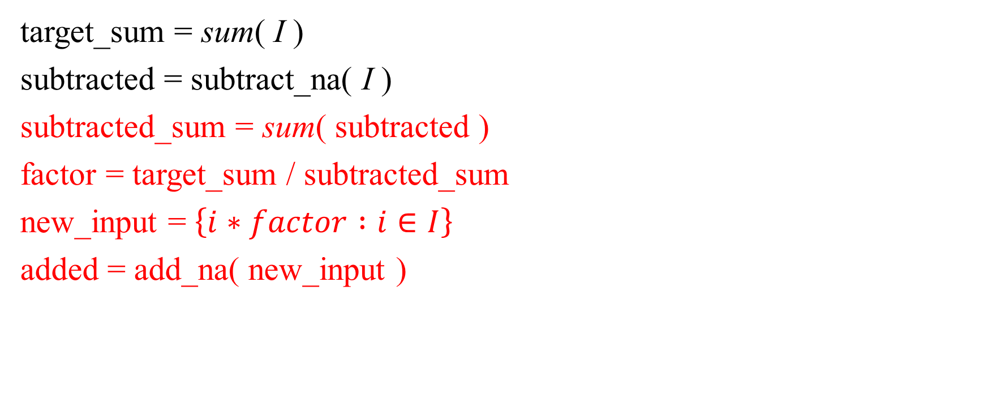
Original Single Tracer Algorithm (4)
target_sum = sum( I )
subtracted = subtract_na( I )
subtracted_sum = sum( subtracted )
factor = target_sum / subtracted_sum
new_input = $\left\{i∗factor :i∈I\right\}$
added = add_na( new_input )

Slide 6
Original Single Tracer Algorithm (5)
add_na( I ):
added = I
for k from len( added ) – 1 down to 0:
added[k] = added[k] * ( 1 – binomial_sum[k] )
for n from 0 to k:
added[k] = added[k] + (added[k] * binomial[n][k] )
return added

Slide 7

Original Single Tracer Algorithm (6)
added = add_na( new_input )
diff = $\sum_{i=0}^{len\left(I\right)}{\left|I\left[i\right]−added\left[i\right]\right|}$
last_diff = diff * 2 ## stopping criterion
while diff < last_diff: ## iterate

Slide 8
Original Single Tracer Algorithm (7)
while diff < last_diff:
new_I = []
for i from 0 to len( I ) – 1:
if I[i] < 0: new_I[i] = I[i]
else: new_I[i] = added[i]

Slide 9
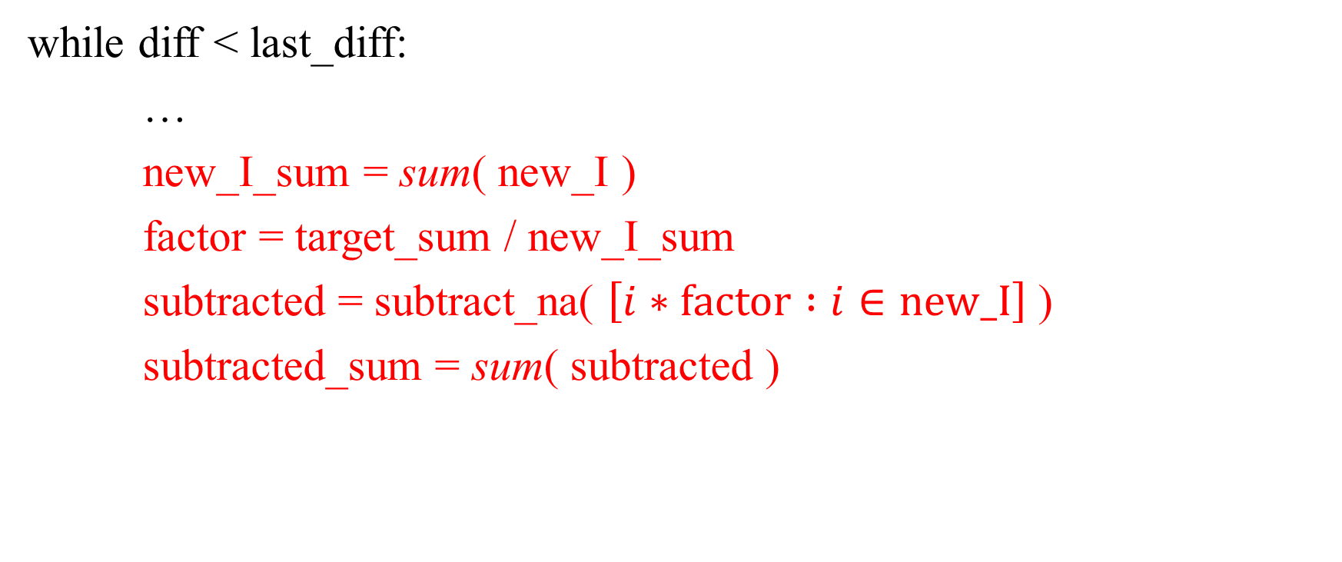
Original Single Tracer Algorithm (8)
while diff < last_diff:
…
new_I_sum = sum( new_I )
factor = target_sum / new_I_sum
subtracted = subtract_na( $\left[i∗factor :i∈new_I\right]$ )
subtracted_sum = sum( subtracted )

Slide 10
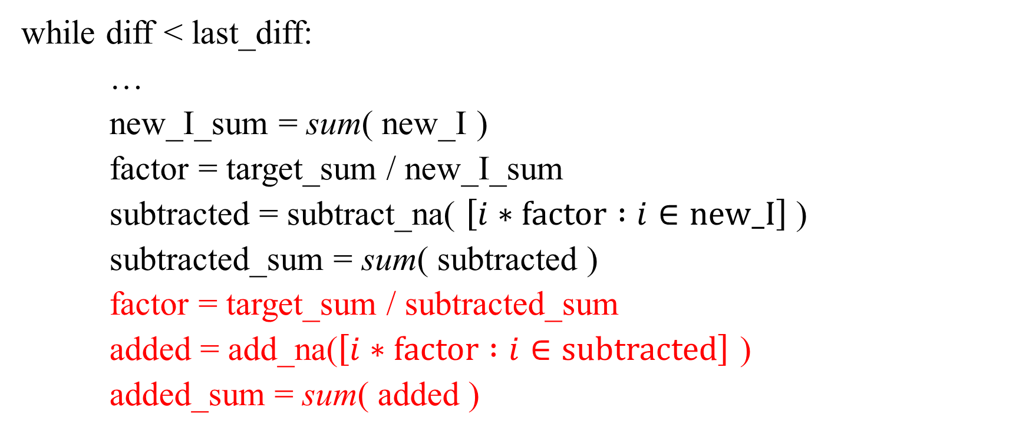
Original Single Tracer Algorithm (9)
while diff < last_diff:
…
new_I_sum = sum( new_I )
factor = target_sum / new_I_sum
subtracted = subtract_na( $\left[i∗factor :i∈new_I\right]$ )
subtracted_sum = sum( subtracted )
factor = target_sum / subtracted_sum
added = add_na($\left[i∗factor :i∈subtracted\right]$ )
added_sum = sum( added )

Slide 11
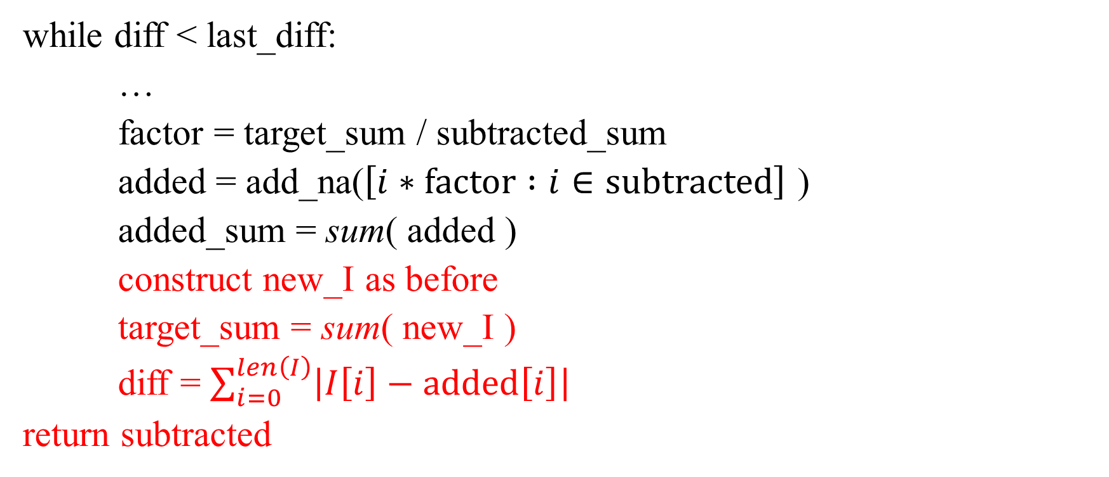
Original Single Tracer Algorithm (10)
while diff < last_diff:
…
factor = target_sum / subtracted_sum
added = add_na($\left[i∗factor :i∈subtracted\right]$ )
added_sum = sum( added )
construct new_I as before
target_sum = sum( new_I )
diff = $\sum_{i=0}^{len\left(I\right)}{\left|I\left[i\right]−added\left[i\right]\right|}$
return subtracted

Slide 12
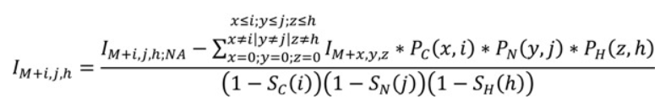
Extension to Multiple Tracers
Lookup tables are calculated as before, one for each stable isotope
In subtract_na and add_na, multiply coefficients for each labeling isotope
Example: subtract_na
binomial
From the original paper:
binomial_sum

Slide 13
Extension to IsoGraph - Benefits
Only corrects for observed isotopologues
No need for complete isotopologue distributions, no peak filling
Partial distributions can be extracted in constant time (less pre-processing)

Slide 14
Extension to IsoGraph - Detriments
Cannot handle ambiguous assignments
i.e. if a peak could be an isotopologue of different monoisotopes, cannot correct its intensity
Automatically detects impossible isotopologues
Filtering could help

Slide 15
Extension to IsoGraph - Implementation
A subgraph in an IsoGraph represents an isotopologue distribution
Pull out any node with a formula assignment and its children (constant time)
Edges to children already labeled with counts of labeling isotopes
Step through corrections using n, k, and MAX_ISOTOPE extracted from IsoGraph

Slide 16
Example (1)
Assume we are correcting the intensities
of acetylene and its isotopologues

Slide 17
Example (2)
Eventually, we’ll end up here

Slide 18
Example (3)
We need to subtract off the
NA contribution of ALL parents
of this node.

Slide 19
Example (4)
¹³C: 1, D: 1
¹³C: 0, D: 1
¹³C: 1, D: 1

Slide 20
Example (5)
Each node remembers its displacement from
the common parent
¹³C: 0, D: 0
¹³C: 1, D: 0
¹³C: 0, D: 1
¹³C: 1, D: 1
¹³C: 0, D: 1
¹³C: 1, D: 1

Slide 21
Example (6)
Each node remembers its displacement from
the common parent
¹³C: 0, D: 0
Values of n
¹³C: 1, D: 0
¹³C: 0, D: 1
¹³C: 1, D: 1
Values of k
¹³C: 0, D: 1
¹³C: 1, D: 1

Slide 22
Example (7)
Each node also remembers its intensity, m/z value,
etc.
For NA correction, the formula must be known,
which provides the maximum count for each
isotope.
This is all the information needed to carry out
the algorithm.

